Slide 1
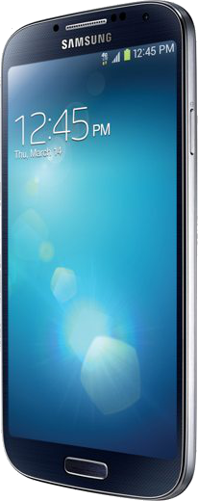
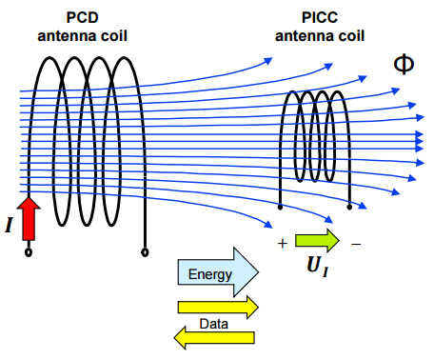

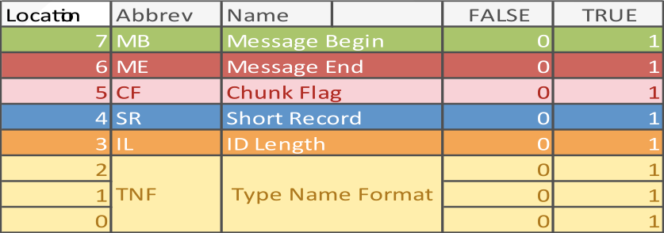

ISO/IEC 14443 specifies the characteristics of the fields to be provided for power and bi-directional communication between proximity coupling devices (PCDs) and proximity cards or objects (PICCs).
INTRODUCTION
Smartphone devices that are NFC-enable operate in reader/writer mode, one of three modes defined by the NFC Forum, when interfacing with passive NFC tags. RF interfaces must be compliant with in order to generate, transmit, and receive messages on ISO/IEC 18000-3 air interface which describes the parameters for air interface communications at 1the ISO 14443 standard 3.56 MHz.
Near Field Communication (NFC) was developed to enable contactless transmission of data. This poster focuses on the electromechanical properties of technology that can generate a message using an Android device (smartphone) and illustrating the standardized format of a typical message facilitating the exchange (NDEF). //add references
Fig. 1
Figure 1 illustrates how a controlled electric current applied to an antenna coil attached to the powered device actively generates a directed electromagnetic field. NFC technology makes use of a phenomenon called electromagnetic induction. The presence/absence of this field over time is used to logically generate a stream of binary data bits.

